Slide 1
Corporate Oppression – At Least There Are No Kids Involved
American Bar Association / Business Divorce Subcommittee Annual Meeting on March 31, 2022
Presented by: Mark C. Rossman | www.rossmanpc.com

Slide 2
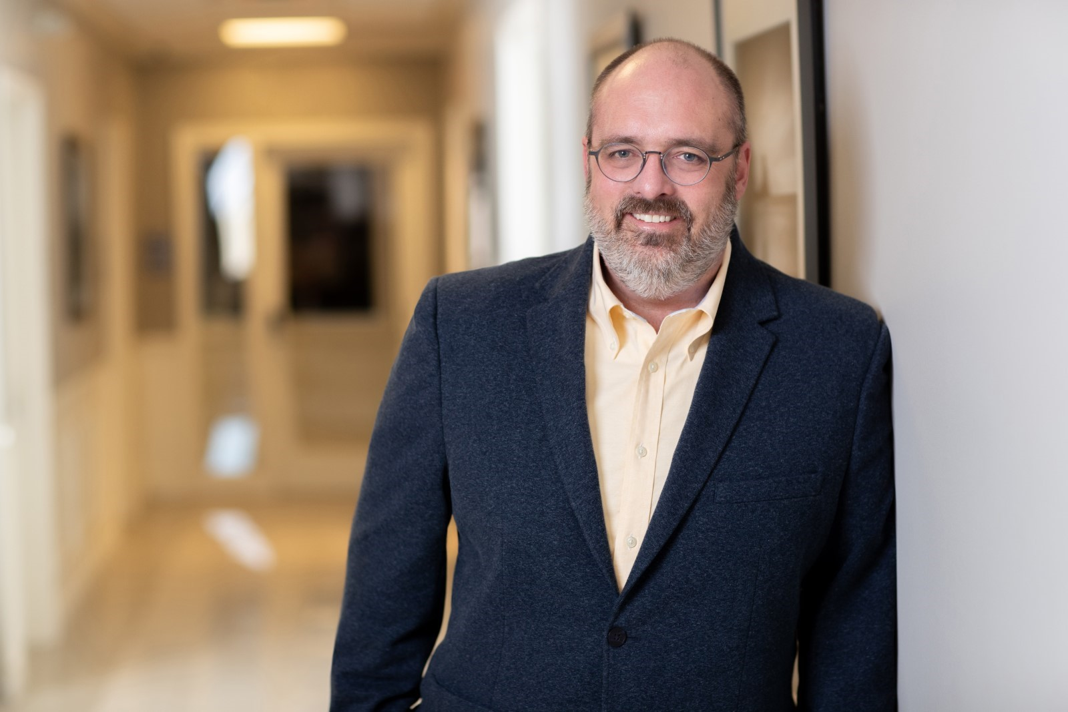
Mark Rossman, Esq.
Managing Partner – Owner
Rossman, P.C.
2145 Crooks Road Suite 220 Troy, MI 48084
rossmanlawpc.com | (248) 385-5481

Slide 3
Be Lively

Slide 4
But Not Too Lively

Slide 5
You have to learn to interrupt because you aren’t going to get called on.
Madeleine Albright

Slide 6
“Not since Cain and Abel have siblings battled with the ferocity of the Pitsch family.”
Hon. Christopher Yates, May 31, 2016
Pitsch v. Pitsch Holding Co

Slide 7
The Business Divorce
“What did I do?”
“You’ll never understand”

Slide 9
“Judicial oversight is probably the worst form of corporate governance known to mankind.” Hon. Christopher Yates July 05, 2017 Pitsch v. Pitsch Holding Co.

Slide 10
“IRAC”
Do we need statutes on these issues? Why is common law fiduciary standard not good enough? The Direct / Derivative conundrum / private versus public.
Persuasiveness in policy arguments when judges sit in equity.
The blood is on their hands.
Who is really vulnerable here? The majority or the minority?
The answer? It’s a very fine line.
Shareholder Expectations – Two Different Kinds
Participatory
Financial
Blue Light Special: To Discount or Not To Discount
Standing Queries
Minority Oppression
Inherited shares
Safe Harbors

Slide 11
Why wasn’t the common law fiduciary standard enough? If centuries of common law precedent is good enough for Delaware why not the rest of us?
Do we even need statutes?

Slide 12
Equity = Discretion = A Mosaic of Case Law and Outcomes

Slide 13
Judge v. Jury
Madugula v. Taub
Michigan Supreme Court, 2014
“Because the equitable nature of Madugula’s claim, the case should have been tried at a bench trial. In addition, the trial court erred by allowing the jury to consider the purely equitable remedy of a forced buyout of stock . . . juries cannot devise specific remedies . . . it was the job of the court sitting in equity to fashion an appropriate remedy.”

Slide 14
Shareholder Expectations
Two types
Participatory
Employment
Management
Control
Financial
Dividends/distributions
Returns on investment
Tax burdens
Contribution

Slide 15
Employment in a Box: Brought to you by MCL 450.1489(3)
(1) A shareholder may bring an action in the circuit court of the county in which the principal place of business or registered office of the corporation is located to establish that the acts of the directors or those in control of the corporation are illegal, fraudulent, or willfully unfair and oppressive to the corporation or to the shareholder. If the shareholder establishes grounds for relief, the circuit court may make an order or grant relief as it considers appropriate, including, without limitation, an order providing for any of the following:
(a)The dissolution and liquidation of the assets and business of the corporation.
(b) The cancellation or alteration of a provision contained in the articles of incorporation, an amendment of the articles of incorporation, or the bylaws of the corporation.
(c) The cancellation, alteration, or injunction against a resolution or other act of the corporation.
(d) The direction or prohibition of an act of the corporation or of shareholders, directors, officers, or other persons party to the action.
(e) The purchase at fair value of the shares of a shareholder, either by the corporation or by the officers, directors, or other shareholders responsible for the wrongful acts.
(f) An award of damages to the corporation or a shareholder. An action seeking an award of damages must be commenced within 3 years after the cause of action under this section has accrued, or within 2 years after the shareholder discovers or reasonably should have discovered the cause of action under this section, whichever occurs first.
(2) No action under this section shall be brought by a shareholder whose shares are listed on a national securities exchange or regularly traded in a market maintained by 1 or more members of a national or affiliated securities association.
(3) As used in this section, "willfully unfair and oppressive conduct" means a continuing course of conduct or a significant action or series of actions that substantially interferes with the interests of the shareholder as a shareholder. Willfully unfair and oppressive conduct may include the termination of employment or limitations on employment benefits to the extent that the actions interfere with distributions or other shareholder interests disproportionately as to the affected shareholder. The term does not include conduct or actions that are permitted by an agreement, the articles of incorporation, the bylaws, or a consistently applied written corporate policy or procedure.

Slide 16
Blue Light Special: To Discount or Not To Discount
Control
Does lack of control impact value? Spoiler alert! It does.
Marketability
Who is going to buy the shares?

Slide 17
“(e) The purchase at fair value of the shares of a shareholder, either by the corporation or by the officers, directors, or other shareholders responsible for the wrongful acts.”
MCL 450.1489(e)

Slide 18
What is Fair Value?
Under US GAAP (ASC 820 formerly FAS 157) and International Financial Reporting Standards (IFRS 13), fair value is the price that would be received to sell an asset or paid to transfer a liability in an orderly transaction between market participants at the measurement date.

Slide 19
Marketability Discounts
“Valuing a closely held corporation is not an exact science because such corporations by their nature contradict the concept of a market value. While sound valuation principles ought to be utilized, the gravamen of the court's valuation is fairness, a notion that is undefined, making it a classic question of fact for the court. Fairness necessarily requires contextualizing the applicable valuation principles to the actual corporation being valued, as opposed to merely deciding a priori, and in a vacuum, that certain adjustments must be part of the court's calculus. Here, the application of a DLOM would have been tantamount to a minority discount—that is, respondent realizing less for her shares because she was being forced to sell while the majority shareholder, who was not likely to give up control of the corporation, got to realize their full value by staying in control… it was fairer to avoid applying a minority discount at all costs rather than ensuring that all hypothetical liquidity risks were accounted for.”
Zelouf Intl. Corp. v. Zelouf, 47 Misc. 3d 346, 347

Slide 20
Under US GAAP (ASC 820 formerly FAS 157) and International Financial Reporting Standards (IFRS 13), fair value is the price that would be received to sell an asset or paid to transfer a liability in an orderly transaction between market participants at the measurement date.
Fair Value – What’s Missing?

Slide 21
Majority Control: Standing
“Contrary to defendants’ argument, the plain statutory language does not require that the plaintiff be a minority shareholder, or show that each defendant individually is a majority shareholder. Rather, subsection 489(1) requires only a showing that the defendants are “in control of the corporation.” Here, plaintiff sufficiently alleged under subsection 489(1) that defendants collectively owned 60 percent of the corporation’s shares and comprised two-thirds of the board of directors, and thus had control over corporate affairs.”
Lozowski v. Benedict, Michigan Court of Appeals, 2006

Slide 22
Inheritance Standing
“Even if an original participant had had a reasonable expectation of personal employment, after his death the surviving shareholders would not be bound to employ any dolt who happened to inherit his stock.”
Gimpel v. Bolstein, 125 Misc. 2d 45, 52 n.6 (N.Y. Sup. Ct. 1984)

Slide 23
The Safe Harbor
What are its boundaries?
Is it a shield or a sword?

Slide 24
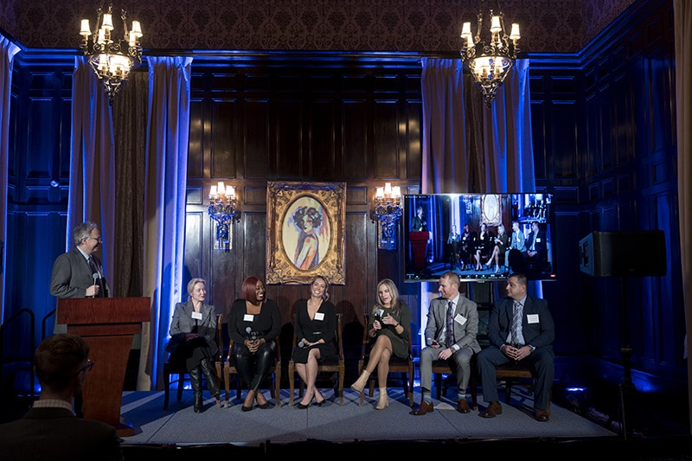
The 2023 Annual State Bar of Michigan Business Law Symposium is currently scheduled to be held on January 20, 2023 | 3:00 – 9:30pm
The Detroit Club
712 Cass Ave, Detroit, MI 48226
For more information please visit: https://bizsymposium.com/

Slide 25
THANK YOU!!

Slide 26
Contact Us!
Mark Rossman, Esq.
-Owner – Managing Partner
-mark@rossmanpc.com
Rossman, P.C.
2145 Crooks Road, Suite 220, Troy, MI 48084
rossmanlawpc.com | (248) 385-5481

